Slide 1
Classify whether the given mail is Abusive or Non-Abusive
Team-3, Python Language
Team members:-
1) Rahul Gadekar
2) Lokesh Gawale
3) Prince Patel
4) Rashmita Surjan
5) Ghanishtha Garothkar
Mentor:- Mr. Tejaswar & Mr. Iswar
Date:- 24/02/2020

Slide 2
Business Problem:-
Inappropriate emails would demotivates and spoil the positive environment that would lead to more attrition rate and low productivity. these emails could be in form of bullying, racism, sexual favourism and hate in the gender or culture, in today's world so dominated by email no organization is immune to these hate emails.
The goal of the project is to identify such emails in the given day based on the above inappropriate content.
Objective:-
The main objective of the project is to develop an accurate predictive Text Classification Model through the Python language, which determines whether an email-message is Abusive or Non-Abusive.

Slide 3
Project Architecture / Project Flow:-
Training data
New Email message input
Data Pre-processing
Model Evaluation
Input Pre-processing
Abusive/
Non Abusive
Feature Engineering
Model Training
Model
Prediction outputs

Slide 4
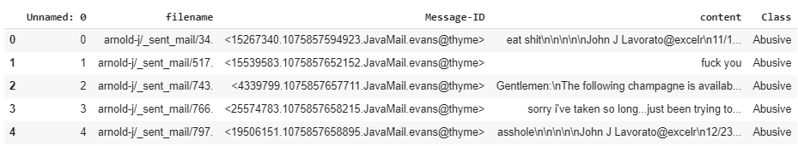
Data set details:
Email messages data set with labeled data:-
It contains,
Total Rows = 48076 & columns = 5
columns = ('Unnamed: 0', 'filename', 'Message-ID‘, ‘content’, ‘Class’)
Drop unwanted columns which are ('Unnamed: 0', 'filename', 'Message-ID’)
final data set contains only 2 columns namely (‘content’ & ‘Class’)
‘content’ contains text email messages which are ‘features’.
‘Class’ contains ‘Abusive’ & ‘Non Abusive’ categories which are
labels.
count values for target columns = Non Abusive : 44666
Abusive : 3410
There are ‘0’ missing(null) value in all columns.

Slide 5
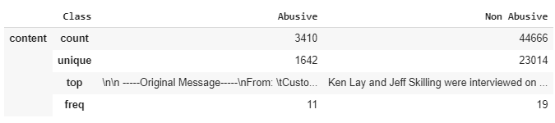
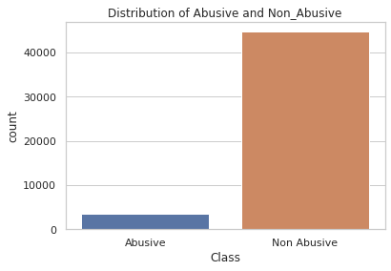
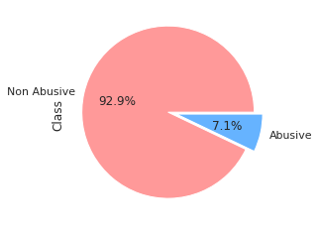
Exploratory Data Analysis (EDA) & Feature Engineering:
Drop unwanted first 3 columns.
Details of Class & content column…
Distribution of Abusive & Non-Abusive Data:-
From above two figures it is clear that Abusive & Non-Abusive data has Class imbalance problem.
so we apply the sampling technique (over-sampling).

Slide 6
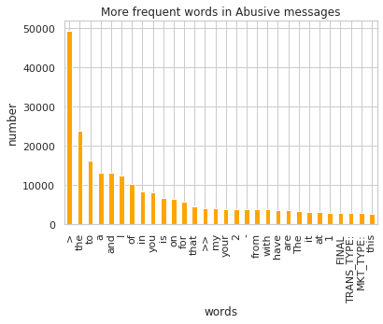
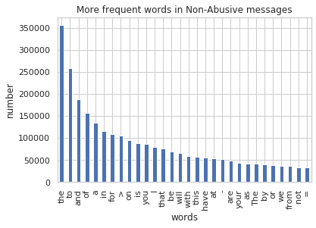
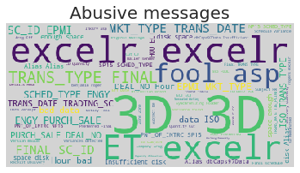
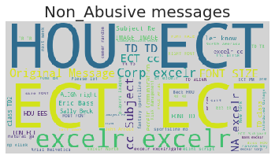
EDA & Feature Engineering:-
Most frequent words in Abusive & Non-Abusive class data:
Majority of most frequent words in both classes are stop words such as ‘to’, ‘the’, ‘a’ etc.
so remove these stop words by putting them into ‘Word Cloud’.
After removing (‘english’) stop words… Word Cloud:-

Slide 7
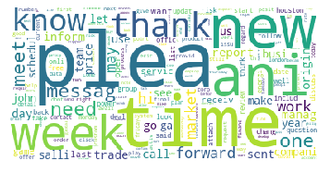
Data Pre-processing:-
Text Cleaning:
To clean the data, explore some common Techniques of NLP…
For that define the ‘clean_text’ function…then,
1) Lower the text & remove spaces
2) Remove the text between square brackets
3) Remove the punctuations
4) Remove html strips
5) Tokenize the text
6) Remove stop words (unwanted words like…excelr, hou, )
7) Apply Porter Stemmer (stemming)
Apply this ‘clean_text’ function on ‘content’ column(which is feature).
Word cloud after all cleaning:
Features & Labels:
X = email(‘content’) …features
y = email(‘label’) …labels
Feature Extraction:
Used Tfidf Vectorizer & take max_features = 10000
then fit the data by ‘fit_transform’

Slide 8
Model Building:-
First of all, split the data into train & test by 70/30 ratio.
We building our model on 6 different Machine Learning algorithms.
They are,
1) Random Forest,
2) Naive Bayes,
3) Support Vector Machine,
4) Decision Tree,
5) Extra Tree classifier,
6) Bagging Classifier (ensemble classifier)
The purpose behind this is deciding which perform the best.
Above all algorithms gives better accuracy(>95%) but we choose
Random Forest from them because it gives high Accuracy, better TPR, FPR, TNR, FNR, recall, & f1-score as compared to others.
It has the power of handle large data sets with higher dimensionality.
It has methods for balancing errors in data sets where classes are imbalanced.
lesser classification error.
It helps to overcome the problem of over fitting.

Slide 9
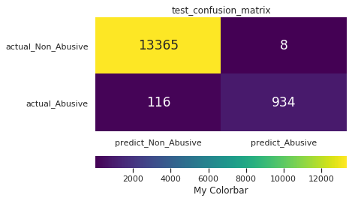
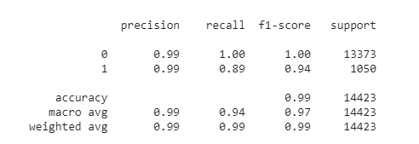
Template for Model results presentation:-
Model – Random Forest
Data set details:
Total Rows = 48076, columns=5
In Tfidf take max_features = 10000
Algorithm: Random Forest Classifier
Algorithm details and configuration:
bootstrap=True,
criterion=‘gini',
n_estimators=100,
random state=252
max_features='auto',
max_depth=None, min_samples_split=2,
max_leaf_nodes=None, n_jobs=None.
Data Partition details:
Split the data into train & test by 70:30 ratio.
Results:- Accuracy: 99.11%
Confusion matrix: Classification Report:
Classification Report

Slide 10
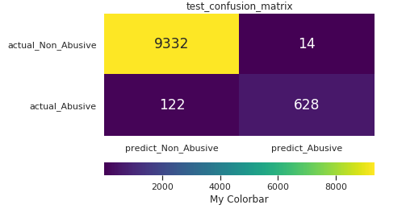
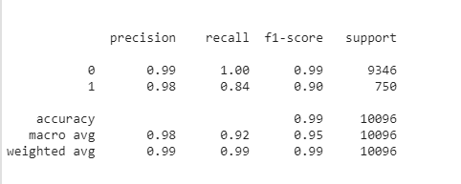
Model Performance:-
Check whether Model is over fit or not by using cross-validation dataset:-
Training Data Cross-validation(test) Data
Accuracy = 99.11% 98.65%
Confusion Matrix:
Classification Report:
By observing both train & cross-validation dataset, it is clear that Accuracy of both almost same(no drastic difference).
Also precision, recall & f1-score observe to be close.
so it’s clear that our model is best fit & there is no over fit as well as under fit.

Slide 11
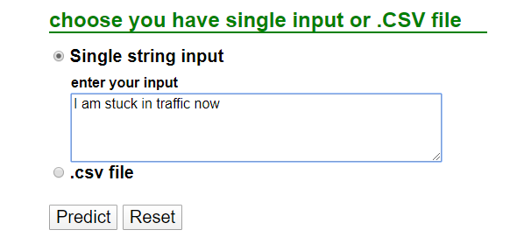
Model Deployment using Flask Framework:-
With help of Flask web framework we build the web application.
we upload test dataset in ‘.csv’ format.
we did it for both text box & csv file to obtain the predictions:
Text box
.csv file
At a time it gives only one output either from ‘text box’ or ‘.csv file’
In ‘text box’ put whatever string input it gives Abusive or Non Abusive as an output.
For ‘.csv file’ put an test data csv file & it gives the prediction of whole observations as an Abusive or Non Abusive in ‘csv file’ format.

Slide 12
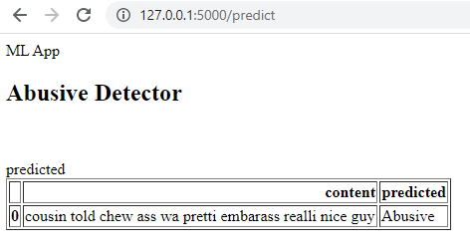
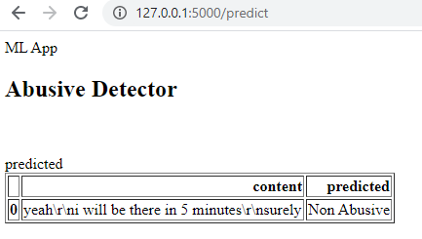
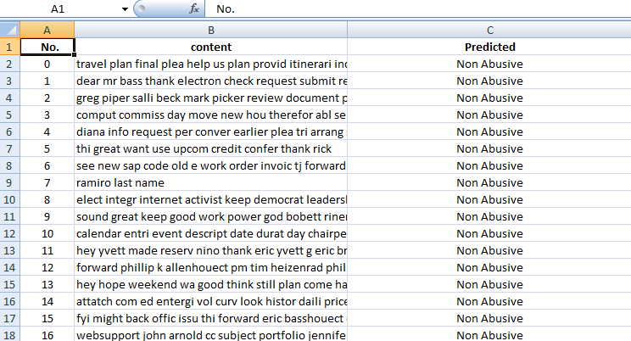
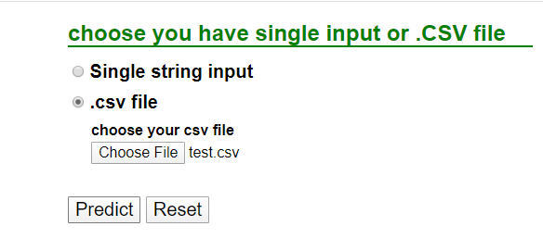
Results/Predictions obtain from deployment:-
Output of single string:
Abusive Prediction
Non Abusive Prediction
Output of csv file:
Predictions of whole observations
Select the test file
Results

Slide 13
Challenges faced?
problem faced during importing the big size csv file(big size data)
Imbalanced class data (93:7 ratio)…
During cleaning, what NLP technique should be preferred stemming or lemmatizing.
Proper Machine Learning Algorithm selection…
At the time of deployment of model in flask, it gives errors continuously like…value error, memory error etc.
How did you overcome?
first did it on some small samples & then perform in Google-colab.
for imbalance class data apply sampling techniques & also cross verify it by checking TPR, FPR, TNR & FNR ratios.
By performing both stemming & Lemmatizing, which gives better results we choose stemming.
Most of the Algorithms gives accuracy>95%, but accuracy is not only the criteria to define a model is best fit or not. So check over fit, confusion matrix, recall, f1-score & mathematical structure behind the algorithm.
searched from Google, kaggle & other resources and apply same on data.

Slide 14
Thank you

